Slide 1

P peline
The Data
Exploratory Data Analysis
© Jennifer Mankoff
The Data Pipeline; HCII; Spring 2014
Notes:
Xx add http://www.wikiwand.com/en/Anscombe%27s_quartet
Xx maybe add something about http://vis.stanford.edu/wrangler/ specifically about how to clean up data.

Slide 2
Goals
After this, you should be able to:
Describe data types and how to transform among them
Draw a stem and leaf plot for a data set
Explain how a box plot works
Recognize common types of distributions and the assumptions that lie behind them
Have strategies for identifying and dealing with outliers
Adapted from http://www.fordham.edu/economics/Vinod/correl-regr.ppt

Slide 3
Exploratory Data Analysis

Slide 4
Goals
Summarizing the Data
Summary Tables
Descriptive statistics
Graphs
Identifying problems (such as outliers)
[eventually] Finding Hidden Relationships
Asking specific questions
Correlations
Grouping
[eventually] Making Predictions

Slide 5
First… What type of data do you have?
How is it structured; if at all?
Does it have multiple tables or just one?
Is it designed for machine consumption or human consumption?
Is it in a database? multiple files or one file?
How are missing values represented?
What are the fields and values?

Slide 6
Laptop Study Mouse Data: Text log files
0,0,CBT:-- --( )--6:5.23:468--Window Created
0,0,CBT:-- --( )--6:5.23:562--Window Created
0,0,CBT:-- --( )--6:5.23:578--Window Activated--(HCII Logging Setup Screen)--main size:--(556,309)--location:--(405,212)
0,0,CBT:-- --( )--6:5.23:609--Window Created
0,0,CBT:-- --( )--6:5.23:609--Window Created
0,0,CBT:-- --( )--6:5.23:609--Window in focus--gotFocus--size:--(445,39)--location:--(500,0)
0,0,MOUSE:----()--6:5.24:46--(457, 545)--MOUSE MOVED--time:--45640--0--0
0,1,CBT:-- --( )--6:5.24:62--unrecognized symbols--unknownWinEvent--size:--(445,39)--location:--(500,0)
0,1,CBT:-- --( )--6:5.24:78--unrecognized symbols--unknownWinEvent--size:--(445,39)--location:--(500,0)
0,1,MOUSE:----()--6:5.26:250--(457, 543)--MOUSE MOVED--time:--47921--0--0
0,2,CBT:-- --( )--6:5.26:250--unrecognized symbols--unknownWinEvent--size:--(445,39)--location:--(500,0)
0,2,MOUSE:----()--6:5.26:250--(457, 543)--MOUSE MOVED--time:--47921--0--0
0,3,MOUSE:----()--6:5.26:265--(458, 541)--MOUSE MOVED--time:--47937--0--0
0,4,CBT:-- --( )--6:5.26:265--unrecognized symbols--unknownWinEvent--size:--(445,39)--location:--(500,0)
0,4,MOUSE:----()--6:5.26:265--(459, 539)--MOUSE MOVED--time:--47937--0--0
0,5,CBT:-- --( )--6:5.26:265--unrecognized symbols--unknownWinEvent--size:--(445,39)--location:--(500,0)
0,5,MOUSE:----()--6:5.26:281--(460, 535)--MOUSE MOVED--time:--47953--0--0
0,6,CBT:-- --( )--6:5.26:281--unrecognized symbols--unknownWinEvent--size:--(445,39)--location:--(500,0)
Notes:
Major parsing effort to create tables!
The original logs did not have consistent logging formats and improper delimiting which has resulted in issues with parsing. Some of these have been fixed, but others may not yet have been found. Typical symptoms include the subfields not correctly matching the expected value from the original log file. Typical errors are caused by log file field delimiters appearing within a field (causing incorrect field tokenization). Other errors caused by unknown and inconsistent log line formats. Different types of log lines had differing line formats and these sometimes changed.

Slide 7
Laptop Study Data Tables
One-time & Qualitative data about participants (participant number; ‘diagnosis’; performance on initial test; etc)
Session data (summary)
Event data (details)
Segment data (summary)
Keyboard key down (if any)?
Mouse features
Target features
…

Slide 8
What Type of Data in Each Field?
Constant (e.g., mouse gain)
Continuous Data (e.g., mouse location)
Discrete Data (often scales)
(e.g., slip/no slip on this interaction)
What are the units?

Slide 9
Scales of Measurement
Nominal (e.g., Diagnosis; Application used)
Ordinal (e.g., “low” “medium” “high”)
Interval (e.g., Index of Difficulty)
Ratio (e.g., Target Sizes)
Notes:
Interval: Scales that describe values where the interval between the values has meaning.
Ratio: Scales that describe variables where the same difference between values has the same meaning (as in interval) but where a double, tripling, etc. of the values implies a double, tripling, etc. of the measurement. An example of a ratio scale is a bank account balance whose possible values are $5, $10, and $15. The difference between each pair is $5 and $10 is twice as much as $5. Since ratios of values are possible, they are defined as having a natural zero.

Slide 10
What Role Does This Field Play?
Descriptor / Feature: predictive of labels (e.g. Click Duration)
Response / Label:
outcome of prediction
response to an intervention / question
(e.g. Diagnosis)
Notes:
Example scripts to address each of these?

Slide 11
Second, Can you compare? Normalization
Allows different fields to be compared
Avoids undue influence of a column that happens to have large values
Often moves data to 0-1 range
Non-linear transformations (e.g., transforming log-normal data to a normal scale by taking the log)

Slide 12
Transforming your data: Ordinal <-> Numeric
Value Mapping
Convert ordinal values into numbers
Discretization
Convert numbers into ordinal values (binning)
Smooth data
Bin Nominal data into categories

Slide 13
Transforming your data: Calculations
Aggregation of Fields
Calculation of Features

Slide 14
Pros and Cons of Transformation
Notes:
----- Meeting Notes (1/29/15 10:06) -----
move to where it is relevant to the data analysis process instead of here.

Slide 15
Simple Statistics

Slide 16
The most common
Min
Max
Mean (Sum/#); Median (Middle #)
8 8 9 10 12 15 17 18

Slide 17
The most common
8 8 9 10 12 15 17 18 19
Min
Max
Mean (Sum/#); Median (Middle #); Mode (most #)
Notes:
Mean = 12.8
Median = 12
Mode = 8

Slide 18
The most common
8 8 9 10 12 15 17 18 19
Min
Max
Mean (Sum/#) = 12.8 Median (Middle #) = 12 Mode (most #) = 8
Notes:
Mean = 12.8
Median = 12
Mode = 8

Slide 19
The most common
8 8 9 10 12 15 17 18 200
Min
Max
Mean (Sum/#) Median (Middle #) Mode (most #)
Notes:
Mean = 33
Median = 12
Mode = 8

Slide 20
The most common
8 8 9 10 12 15 17 18 200
Min
Max
Mean (Sum/#) = 33 Median (Middle #) = 12 Mode (most #) = 8
Variance σ² (Mean of [Square of diff from mean])
(33-8)²*2+(33-9)²+(33-10)²+… (33-200)² [N-1]
Notes:
N-1 is for sample; use N for population

Slide 21
The most common
8 8 9 10 12 15 17 18 200
Min
Max
Mean (Sum/#) = 33 Median (Middle #) = 12 Mode (most #) = 8
Variance σ² = 3936.25
Standard Deviation σ = 62.7
Notes:
N-1 is for sample; use N for population

Slide 22
The most common
8 8 9 10 12 15 17 18 19
Min
Max
Mean (Sum/#) = 12.8 Median (Middle #) = 12 Mode (most #) = 8
Variance σ² = 19.6
Standard Deviation σ = 4.5
Notes:
N-1 is for sample; use N for population

Slide 23
Visual Representations of your Data

Slide 24
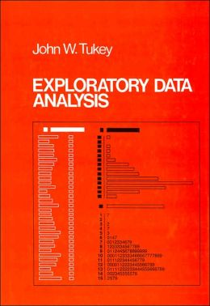
Visual Tool Chest: Stem and Leaf
Tukey’s tool of choice first
Easy to do by hand
Careful design adds value

Slide 25
Exercise: Stem and Leaf of Zip?
Printout of summary .csv file for you (already done half the work here). Look at columns 5/6
40175 x x x
40201 x x x
40224 x x x
37013 x …
Notes:
Have them do an exercise in class

Slide 26
Exercise: Stem and Leaf of Zip?
Alternative: Digit reminder representation (columns 5-8 only here):
400* 33 55 57 68 08 08 19 19
401* 04 08 76 95 75 75 75 19 19 50 50 85 85
* 53 65 70 77 79 01 01 01 24 24 24 27 27 56 56 71 17 95 95
* 90
405* 03 05 11 15
…
Notes:
Have them do an exercise in class

Slide 27
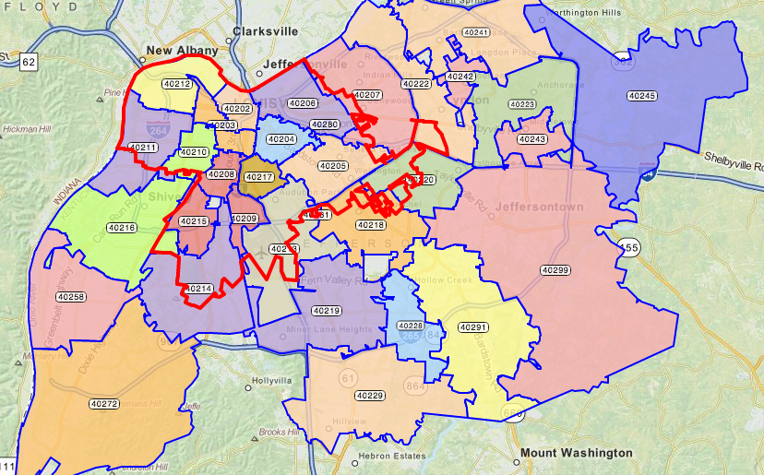
Aside – what do we expect to see?

Slide 28
Exercise: Stem and Leaf of Zip?
What about column 1-4’- data?
402*: 15 15 15 15 15 15 15 15 … 2034 times; 16 … 640 times; …
How could we represent that?
Notes:
- Could represent using 10s or 100s per ‘digit’ (but what do we do about 2 digits in this case? Round to 0?)
- Other ideas?

Slide 29
Exercise: Stem and Leaf of Zip?
What about column 1-4’- data?
402*: 15 15 15 15 15 15 15 15 … 2034 times; 16 … 640 times; …
1000s? (round up?)
402*: 15 15 16 …
Notes:
- Could represent using 10s or 100s per ‘digit’ (but what do we do about 2 digits in this case? Round to 0?)
- Other ideas?

Slide 30
Exercise: Stem and Leaf of Zip?
What about column 1-4’- data?
402*: 15 15 15 15 15 15 15 15 … 2034 times; 16 … 640 times; …
1000s? (round up?)
402*: 15 15 16 …
Counting to 10 (or 100):
. ☐ ☐
. . ☐ ☐
.
. . ☐
. .
. . ☐
Notes:
- Could represent using 10s or 100s per ‘digit’ (but what do we do about 2 digits in this case? Round to 0?)
- Other ideas?

Slide 31
Exercise: Stem and Leaf of Zip?
What about column 1-4’- data?
402*: 15 15 15 15 15 15 15 15 … 2034 times; 16 … 640 times; …
1000s? (round up?)
402*: 15 15 16 …
‘visual’ 100s
402*: 15 ☐☐16☐ 72 ☐ 14 ☐ 19 12 11 58 29 18
10 91 03 99 08 13 18 20 17 28 06 …
. .
. .
. .
. .
. .
. .
. .
. .
. .
. .
.
. .
.
. .
.
.
.
.
.
.
.
.
.
.
.
.
.
.
.
Notes:
Could represent using 10s this way too… or thousands
What do we do when the range is so big?
What do we do about the long tail?

Slide 32
Wide Range of Uses (e.g.)
 |  | <6mo | 6mo-1y | 1-6 | 7+
 | ☐ | . . | . . | ☒ . . | ☐
Lost Reported Expired | ☒ ☒ ☒ ☒ ☒ ☒ ☒ ☒ ☒ ☒ ☒ ☒ ☒ ☐ | . |  | . | .
Foster | ☒ ☒ ☐ | ☒ ☒ ☒ ☒ ☒ ☒ ☒ ☒ ☒ ☒ ☒ ☒ . | ☒ ☒ . | ☒ ☒ ☒ ☒ ☒ ☒ ☒ ☐ | ☒ ☐
Missing | ☐ . | . . |  |  | . .
Returned to Owner | ☒ ☒ ☒ ☒ ☒ ☒ ☒ ☒ ☒ ☒ ☒ ☒ ☒ ☒ ☒ ☒ ☒ ☒ ☒ ☒ ☒ ☒ ☒ ☒ ☒ ☒ ☒ ☒ ☒ ☒ ☒ ☒ ☒ ☒ ☒ ☒ ☒ . . | ☒ ☒ ☒ ☒ ☒ ☒ | ☒ ☒ ☒ ☒ ☒ ☒ ☒ ☒ ☒ ☒ ☐ |  | ☒ ☒ ☒ ☒ ☒ ☒ ☒ ☒ ☒ ☒ ☒ ☒ ☒ ☒ ☒ ☒ ☒ ☒ ☒ ☒ ☒ ☒ ☒ ☒ ☒ ☒ ☒ ☒ ☐
Disposal | ☒ ☒ ☒ ☒ ☒ ☒☐ | . . |  |  | ☒ ☐
Transferred to Rescue
Found Expired
Adopted
Euthanized
Released in Field
No Show
Died

Slide 33
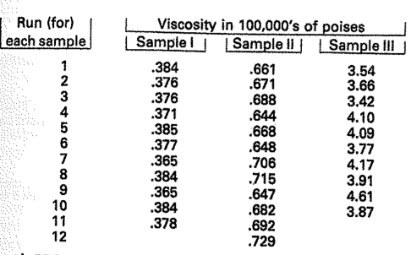
Example of comparison

Slide 34
Exercise: Stem and Leaf of Zip?
Now you do it…
What about column 1-4’- data?
402*: 15 15 15 15 15 15 15 15 … 2034 times; 16 … 640 times; …
1000s? (round up?)
402*: 15 15 16 …
‘visual’ 100s
402*: 15 ☐☐16☐ 72 ☐ 14 ☐ 19 12 11 58 29 18
10 91 03 99 08 13 18 20 17 28 06 …
. .
. .
. .
. .
. .
. .
. .
. .
. .
. .
.
. .
.
. .
.
.
.
.
.
.
.
.
.
.
.
.
.
.
.
Notes:
Could represent using 10s this way too… or thousands
What do we do when the range is so big?
What do we do about the long tail?

Slide 35
Benefits of Steam + Leaf
Quick & easy to produce; very flexible
Easy to annotate in all sorts of ways; use for comparison (of different samples); etc
Help to highlight unsymmetric trailing off
Help to highlight popular/unpopular values
About where values are ‘centered’
About how widely values are ‘spread’

Slide 36
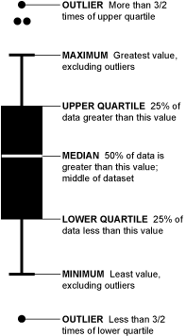
Boxplot (invented by Tukey) [image from flowingdata.com/2008/02/15/how-to-read-and-use-a-box-and-whisker-plot/]
Notes:
Can show certain types of unexpected structure (e.g. variance)
You can also see which way the data sways. For example, if there are more people who eat a lot of burgers than eat a few, the median is going to be higher or the top whisker could be longer than the bottom one. Basically, it gives you a good overview of the data's distribution.
Some variation in how these are assigned…

Slide 37
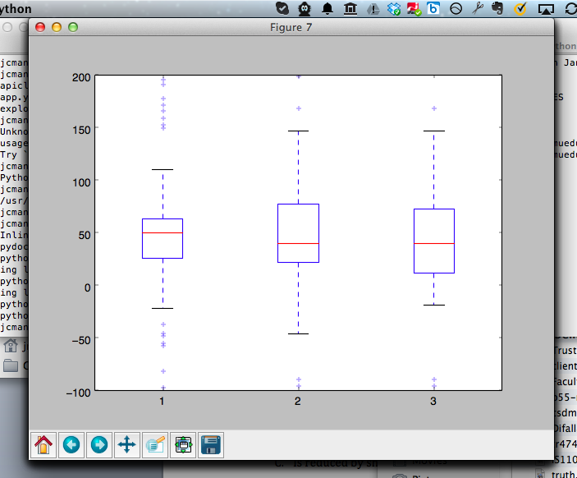
Boxplot [Random Data; 3 times]
Notes:
Boxplots make comparison really easy …
Can also show certain types of unexpected structure (e.g. variance variance)
Created with ‘boxplot-demo.py’
Box is 25%
Line is median
Dots are outliers
Xx update

Slide 38
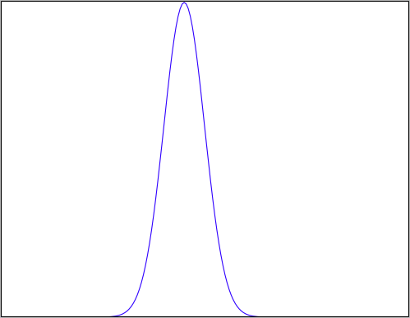
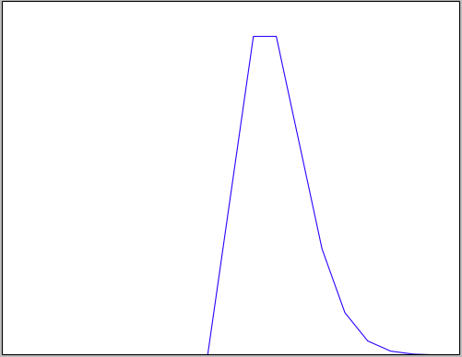
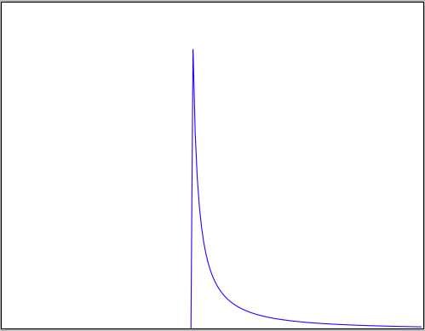
Histograms: Checking a Distribution
Histogram (eyeball)
Example distributions:
Normal
Poisson
Log Normal
Notes:
Example

Slide 39
What your distribution implies: Normal Distribution
Properties:
No long tail (bell shaped)
Symmetric
Mean median & mode equal & in the middle
~68% within 1 SD of mean
~95% within 2 SD of mean
Almost all lie within 3SD of the mean
Histogram looks bell shaped
Notes:
Example

Slide 40
When might we expect a Normal distribution?
Central limit theorem: Sum of independent and identically distributed random variables will converge to normal

Slide 41
Random Variable
Value varies (e.g. possible outcomes of an experiment)
Modeled as a distribution
Discrete values (“Probability Mass Function”) - typically values and weights
Continues values (“Probability Density Function”) – typically a function

Slide 42
Independent Identically Distributed
Are the observations independent of each other?
Do they directly influence each other
Are they both influenced by a shared hidden confounding variable?
Are the random variables identically distributed?
Is the variance equivalent
Are the min/max/SD equivalent
Kolmogorov-Smirnov Test
Notes:
http://www.physics.csbsju.edu/stats/KS-test.html
One of the advantages of the KS-test is that it leads to a graphical presentation of the data, which enables the user to detect normal distributions (see below).
The KS-test is a robust test that cares only about the relative distribution of the data.

Slide 43
Example: Mouse Motion Length
Normal Distribution: Mouse Motion Length across all interactions
Random Variable: An interaction
Discrete or Continuous?
Independence? When might this be true/untrue?
Identical Distributions?
Notes:
Discrete values (“Probability Mass Function”) - typically values and weights
Continues values (“Probability Density Function”) – typically a function
Affects how we model the variable
Insurance claims: Not independent when an epidemic hits the local population (common location affects health)
Identical distributions not the same in terms of chance of being sick when one person has higher likelihood of inheriting a disease or is in a socioeconomic class more at risk for disease

Slide 44
What your distribution implies: Normal Distribution
Properties:
No long tail (bell shaped)
Symmetric
Mean and median equal & in the middle
~68% within 1 SD of mean
~95% within 2 SD of mean
Almost all lie within 3SD of the mean
Histogram looks bell shaped
Assumptions:
Sum of random variables
Independent
Identically distributed
Notes:
XX why do I have this slide twice?

Slide 45
What your distribution implies: Log Normal Distribution
Properties:
Not Symmetric
Log of this random variable follows a normal dist.
Test
Take log and test for normality
Make transform data for further analysis
Assumptions:
Multiply random variables
Independent
Identically distributed
Notes:
A variable might be modeled as log-normal if it can be thought of as the multiplicative product of many independent random variables each of which is positive. (This is justified by considering the central limit theorem in the log-domain.) For example, in finance, the variable could represent the compound return from a sequence of many trades (each expressed as its return + 1); or a long-term discount factor can be derived from the product of short-term discount factors. In wireless communication, the sas caused by shadowing or slow fading from random objects is often assumed to be log-normally distributed: see log-distance path loss model.
What part of amy’s data might match a log distribution?

Slide 46
What your distribution implies: Poisson Distribution
Properties:
Not Symmetric
The expected value of the distribution is equal to its variance
Examples:
Cars arriving at a traffic light
Number of times a web server is accessed per minute
Assumptions:
Events occur at a constant rate
Events are independent of each other
Events do not occur simultaneously
Notes:
For instance, suppose someone typically gets 4 pieces of mail per day on average. There will be, however, a certain spread: sometimes a little more, sometimes a little fewer, once in a while nothing at all.[2] Given only the average rate, for a certain period of observation (pieces of mail per day, phonecalls per hour, etc.), and assuming that the process, or mix of processes, that produces the event flow is essentially random, the Poisson distribution specifies how likely it is that the count will be 3, or 5, or 10, or any other number, during one period of observation. That is, it predicts the degree of spread around a known average rate of occurrence.[2]
mean equals the variance

Slide 47
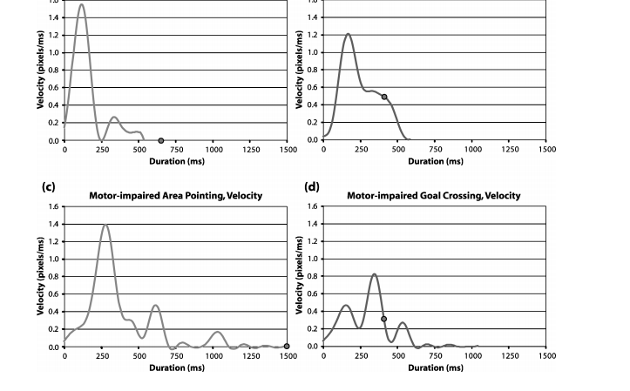
Domain matters: Min-jerk profile
Jacob O. Wobbrock and Krzysztof Z. Gajos. 2008. Goal Crossing with Mice and Trackballs for People with Motor Impairments: Performance, Submovements, and Design Directions. ACM Trans. Access. Comput. 1, 1, Article 4 (May 2008), 37 pages. DOI=10.1145/1361203.1361207 http://doi.acm.org/10.1145/1361203.1361207
Notes:
Fig. 17. Velocity proﬁles over time using the mouse for (a,b) able-bodied participants and (c,d)
motor-impaired participants. The dot represents the click or crossing event. The graphs on the
left are for area pointing. The graphs on the right are for goal crossing.

Slide 48
Value of Histograms
Helps you check: Do assumptions match your data?
Gives a sense of the distribution

Slide 49
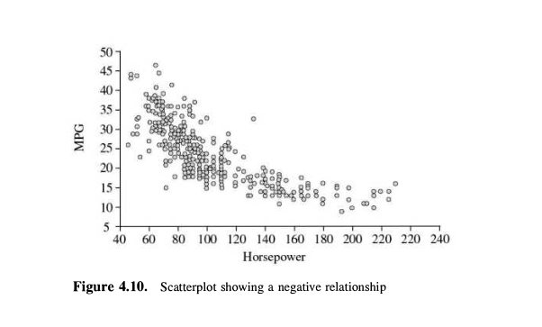
Scatter Plots and Correlation

Slide 50
Scatter Plots and Correlation
A scatter plot & correlation analysis are measures of association (linear relationship) between two variables
These variables change together
Usually scale (interval or ratio) variables

Slide 51
What is “Linear”?
Remember this:
Y=mX+B?
m (slope)
B (intercept)
Adapted from: http://www.sjsu.edu/people/steven.macramalla/courses/stats95/s1/lecture 10
Notes:
A slope of 2 means that every 1-unit change in X yields a 2-unit change in Y.

Slide 52
Scatter Plot Examples
Linear relationships
Curvilinear relationships
y
y
x
x
y
y
x
x
Adapted from http://www.fordham.edu/economics/Vinod/correl-regr.ppt

Slide 53
Scatter Plot Examples
(continued)
Strong relationships
Weak relationships
y
y
x
x
y
y
x
x
Adapted from http://www.fordham.edu/economics/Vinod/correl-regr.ppt

Slide 54
Scatter Plot Examples
(continued)
No relationship
y
x
y
x
Adapted from http://www.fordham.edu/economics/Vinod/correl-regr.ppt

Slide 55
Goals
Summarizing the Data
Summary Tables
Descriptive statistics
Graphs
Identifying problems (such as outliers)
[eventually] Finding Hidden Relationships
Asking specific questions
Correlations
Grouping
[eventually] Making Predictions

Slide 56
Identifying Problems
An outlier is anomalous entry with respect to the data set
Univariate detection depends on understanding nominal data [need a sense of the distribution]
Simplest is >3σ from the mean
Other techniques described in reading

Slide 57
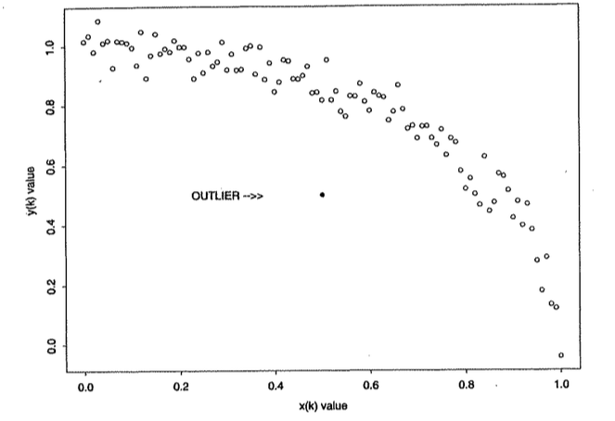
Identifying Problems
An outlier is anomalous entry with respect to the data set
Multivariate detection more complex

Slide 58
Are all outliers problems?
Discuss uses for outliers…

Slide 59
Things we talked about
Transformations such as normalization, logs, and feature creation
Plots and their value
stem & leaf: flexible & quick
boxplot: supports comparison
Histogram: check a distribution
Scatterplot: linear relations
Notes:
relating distributions back to your understanding of the data

Slide 60
Things we talked about
Transformations such as normalization, logs, and feature creation
Plots and their value
Distributions
Normal: Independent, Identically distributed random variables
Log Normal: Multiplied independent random vars (intuitively: one end is fixed, e.g. timings all > 0)
Poission: Constant rate of independent events
Notes:
relating distributions back to your understanding of the data

Slide 61
Things we have not talked about
Acquiring the data
Cleaning the data
Notes:
relating distributions back to your understanding of the data

